Slide 1
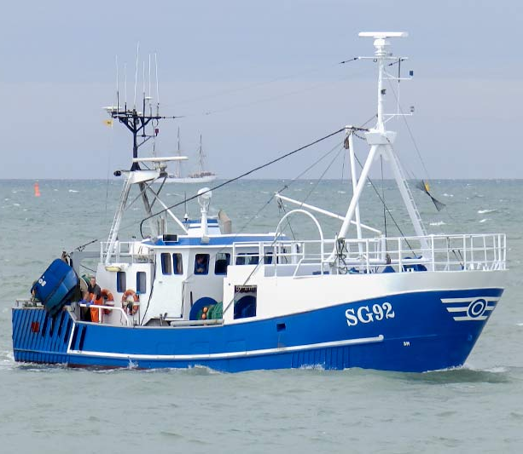

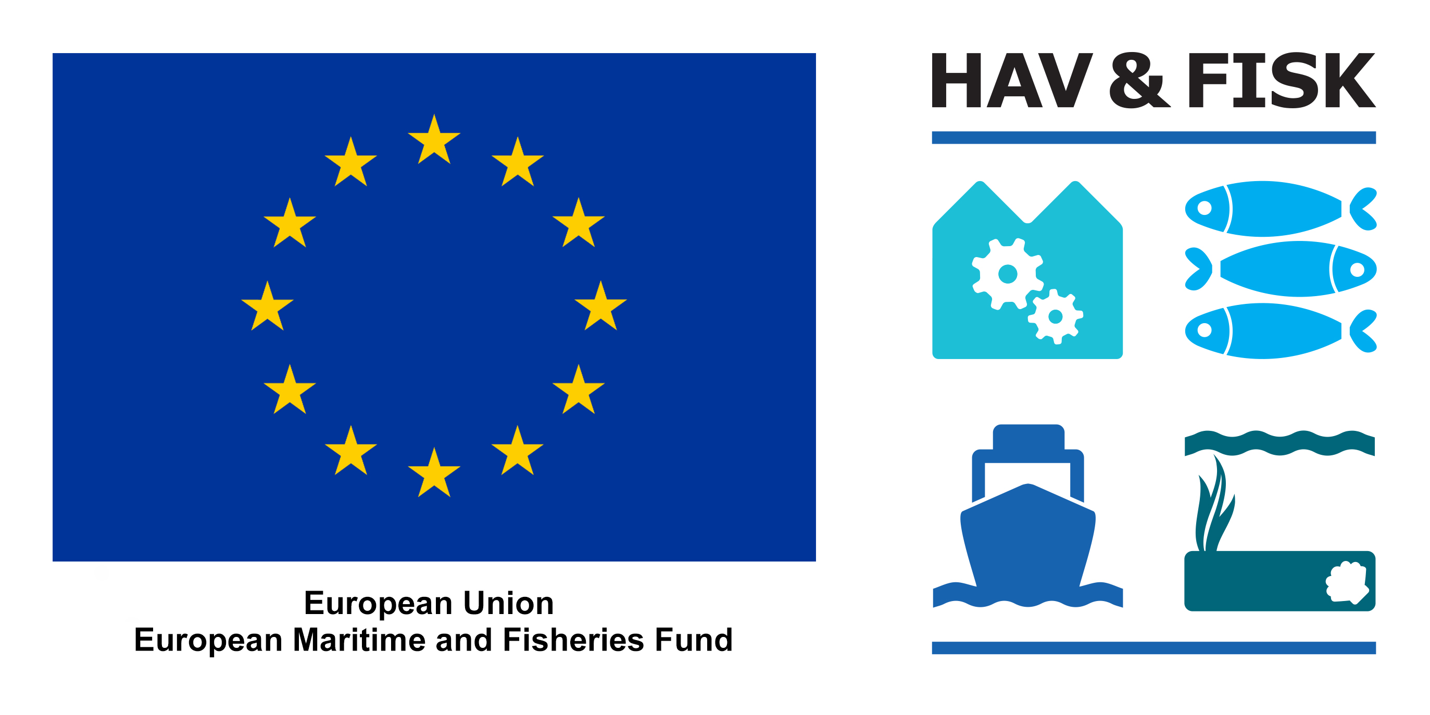
Compare the selectivity of Roofless to the large meshes (800 mm) in the upper panel of the trawl
AIM
Reduce catches of cod while retaining commercially important flatfish species
TARGET SPECIES
Plaice (Pleuronectes platessa)
Flounder (Platichthys flesus)
Dab (Limanda limanda)
Cod (Gadus morhua)
AREA, VESSEL
Baltic Sea (ICES subdivision 24)
Stern trawler (17 m, 221 kW)
GEAR TRIALS
Two trawls were fished in parallel for a month in October 2023. Both trawls were mounted with BACOMA 120 mm codends. One of the trawls had a section of large meshes (800 mm) mounted in the upper panel of the trawl and the other had Roofless mounted in the extension piece. Data were collected by the crew on the vessel.
RESULTS
When fishing with Roofless, cod catches were reduced by 52 % when compared to the large mesh panel. However, catches of cod during the trial were low (156 kg), counting for only 1.1 % of total catches. For flatfish, catches were reduced by 10 - 26 % (10 % for flounder, 17 % for plaice and 26 % for dab).
FURTHER INFORMATION
Jordan Feekings (jpfe@aqua.dtu.dk)
SKIPPERS COMMENTS
The trawl worked well under fishery and resulted in a clean flatfish fishery

