Slide 1
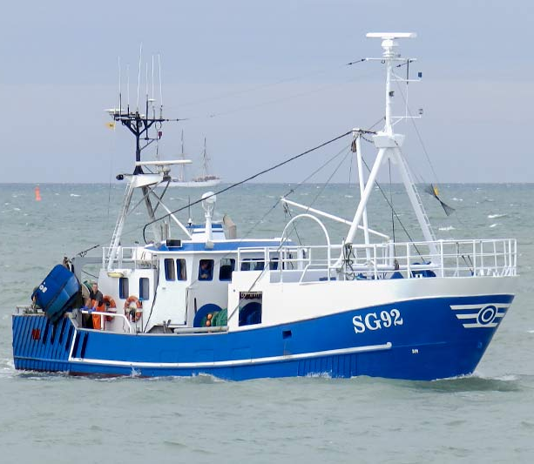

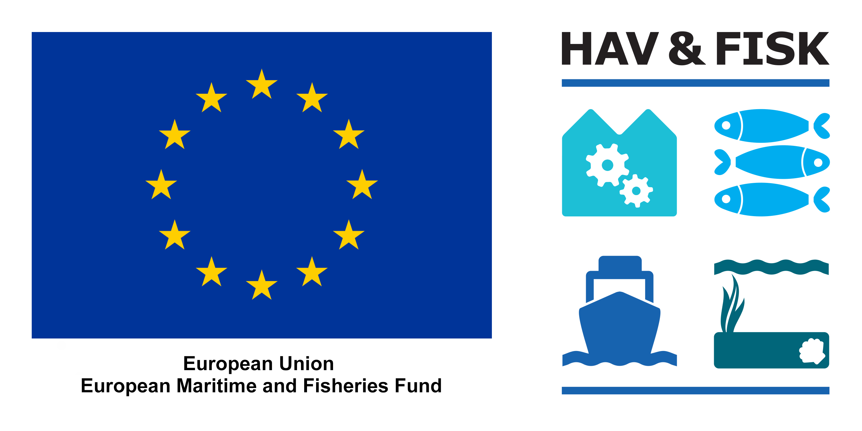
Large meshes (800 mm) in the upper panel of a trawl to reduce catches of cod in a flatfish fishery
AIM
Reduce catches of cod while retaining commercially important flatfish species
TARGET SPECIES
Plaice (Pleuronectes platessa)
Flounder (Platichthys flesus)
Dab (Limanda limanda)
Cod (Gadus morhua)
AREA, VESSEL
Baltic Sea (ICES subdivision 22)
Stern trawler (17 m, 221 kW)
GEAR TRIALS
Two trawls were fished in parallel for a month in March and April 2023. Both trawls were mounted with BACOMA 120 mm codends. One of the trawls had a section of large meshes (800 mm) mounted in the upper panel of the trawl. Data were collected by the crew on the vessel.
RESULTS
Catches of cod during the trial were low (752 kg), counting for only 3.6 % of total catches. When fishing with large meshes in the upper panel, cod catches were reduced by 38 % while catches of flatfish were reduce by 9-11 %.
FURTHER INFORMATION
Jordan Feekings (jpfe@aqua.dtu.dk)
SKIPPERS COMMENTS
The trawl worked well under fishery and resulted in a clean flatfish fishery

